Slide 1
Fundamentals of Python
Introduction to MSP Program
Kartik Garg (Microsoft Student Partner)
Beta Partner

Slide 2
Our Team Members..
Naman Modi ( Microsoft Student Partner alpha2)
Harshit Gupta (CISCO certified in Python)
Dhaval Maniyar (Expert in SQL and Java)
Gourav Jaiswal ( Expert in Frontend development)
Gitanjali Prasad( Expert in frontend development)
Ishika Jain (Expert in Python Development and Data science)
Our team members are active in the QnA section for all your queries .Please feel free to reach them out.

Slide 3
History of Python..
Python is an old language created by Guido Van Rossum. The design began in the late 1980s and was first released in February 1991.
Why Python was created?
Guido was working on the Amoeba distributed OS group. He wanted to use an interpreted language like ABC (ABC has simple easy-to-understand syntax) that could access the Amoeba system calls. So, he decided for creation of language that was extensible. which was later named Python.
Why the name Python?
No, It wasn't named after a dangerous snake. Rossum was fan of a comedy series from late seventies. The name "Python" was adopted from the same series "Monty Python's Flying Circus".

Slide 4
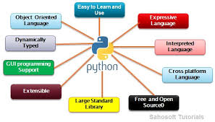
Features of Python.

Slide 5
Python “Hello World”
print(“Hello world!”)

Slide 6
Python
Python Variables:
a=10 (int)
b=1.5 (double)
c=“Abc”(string)
Python Output:
print(“hello, there!”)
Python Input:
a=input(“enter the value”) # By default it takes it as a string

Slide 7
If-else in python
Helps in decision making .
Executes the conditions and run the required condition according to the situations.

Slide 8
Loops in Python
Helps to perform a same task multiple times.
Makes your work very easy.
There are 3 types of loops in python
While loop
For loop
Do-While loop

Slide 9

GeeksGod.com
GeeksGod is an educational platform aiming to provide technical as well as career growth assistance to students pursuing various STEM fields such as computer science, electronics engineering, etc.
I would thank Geeksgod to be as our promotion partner.

Slide 10
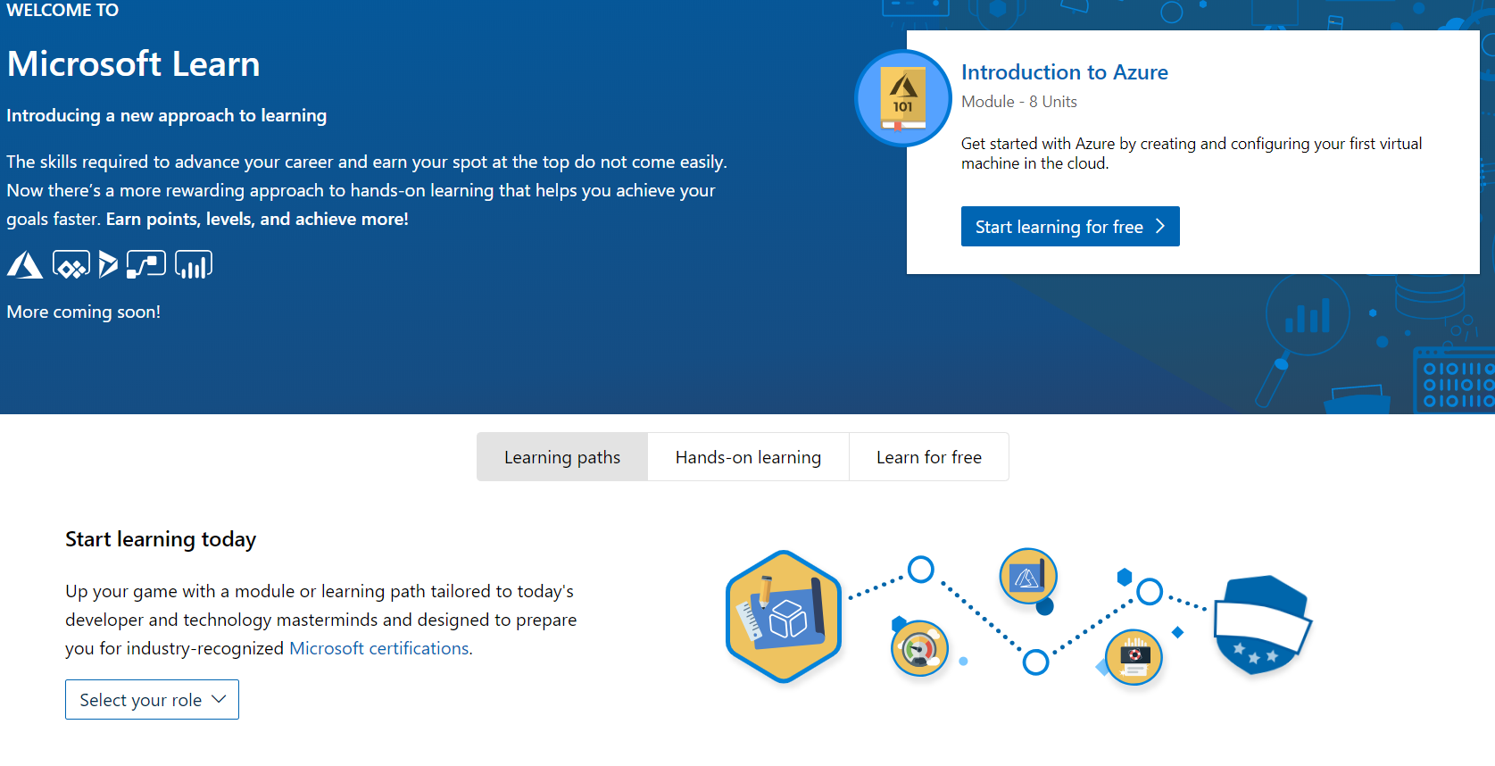
Microsoft Learning
https://docs.microsoft.com/learn/

Slide 11
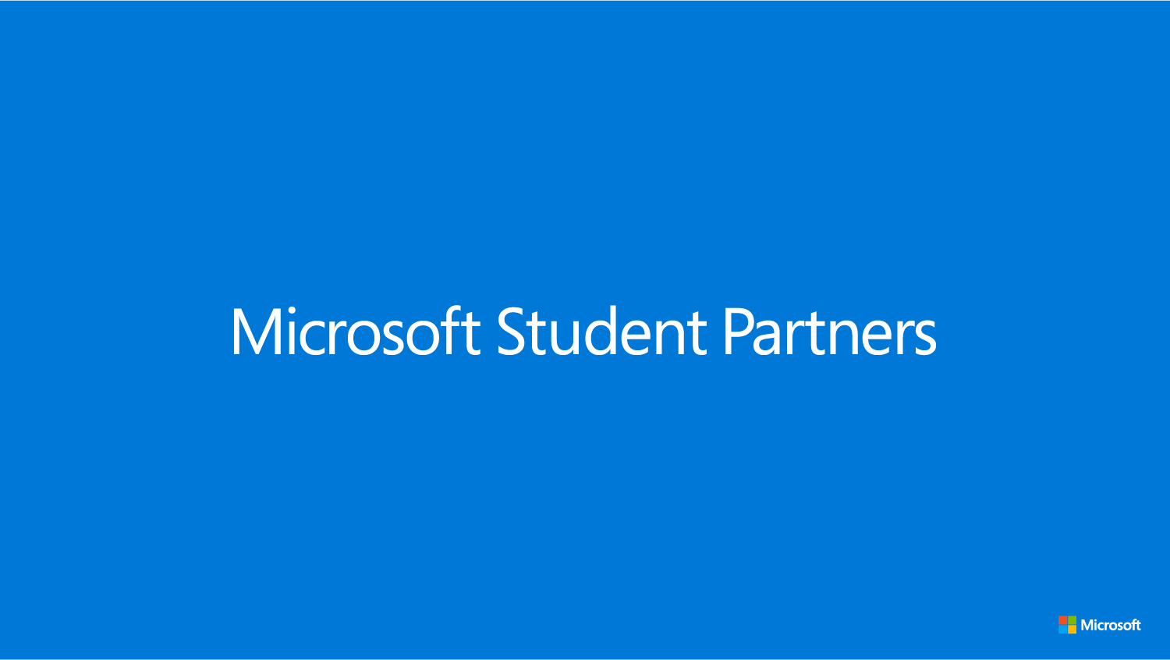
Introduction to
Microsoft Learn Student Ambassadors Program

Slide 12
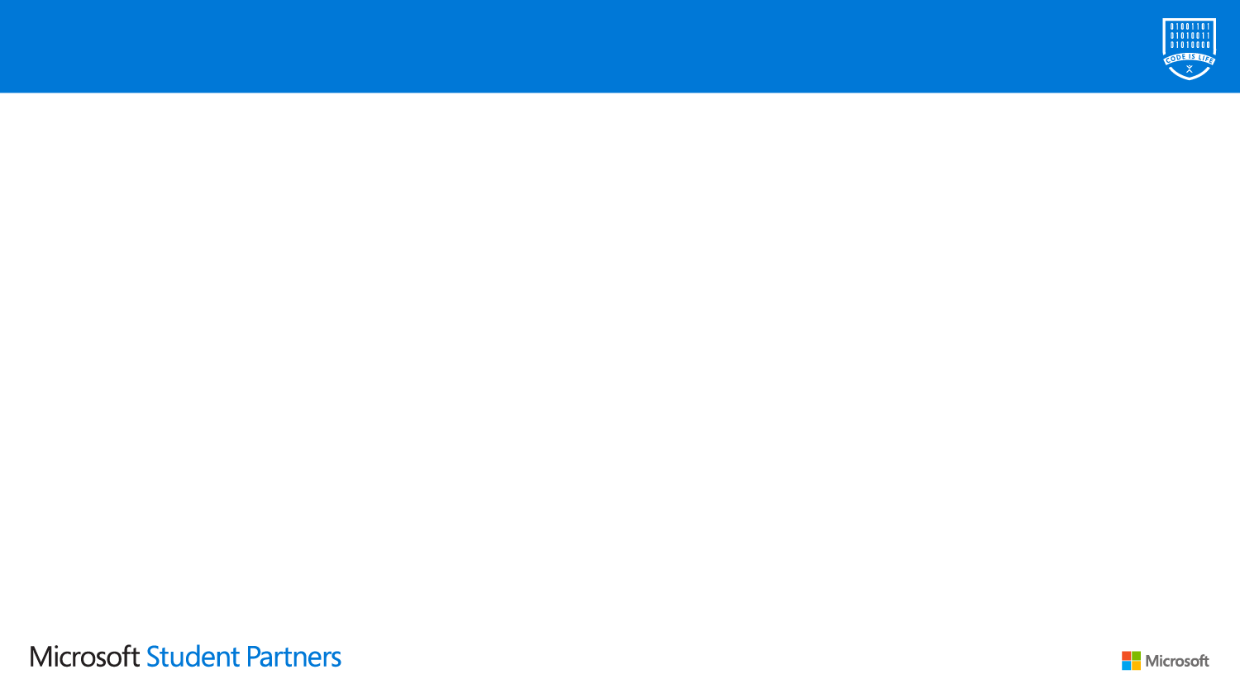
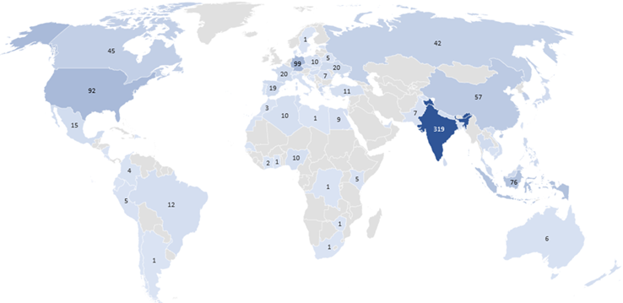
A global community of tomorrow’s leaders
1,467 students across 755 universities in 71 countries
95% engineering / computer science
17% pursuing Masters / PhDs
21% female / 79% male

Slide 13
Program Overview
The Microsoft Student Partners program is a global community of university students with a common interest in technology and making a difference in the world around them. Student Partners are a peer to peer learning network, empowered to lead and build communities on their local campuses and share their knowledge and passion for Microsoft technologies with their fellow classmates.
Join – Connect with your teammates and gain access to resources
Learn – Gain knowledge and understanding according to your individualized needs
Execute – Carry out events to influence your community and reinforce your expertise
Lead – Guide other MSPs along the way and strengthen your coaching
Graduate – Transition from academic to professional with real world expertise

Slide 14

MSPs get free certs.
https://www.microsoft.com/learning/ browse-new-certification.aspx
Would you like to get certified?
Write a blog post or record a video tutorial to help others learn a concept required for the Azure exam.
Send MSP-Help@Microsoft.com a link to the published blog post or video tutorial.
Upon review, MSP-Help will send you a voucher for a free certification exam.
After you pass your first exam, you may write another blog post or record another video tutorial to earn a second voucher.
Limited number of vouchers available. Offer valid while supplies last or until March 31, 2019 – whichever comes sooner.

Slide 15
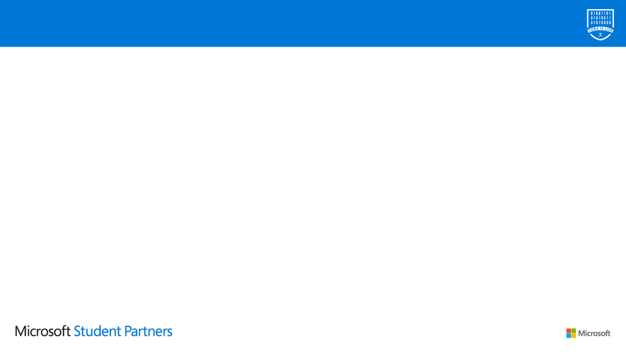
All the benefits in one place.
Everyone gets:
$150 monthly of Azure Cloud
Office 365 subscription
Visual Studio subscription
Microsoft Learn skilling
Free Certifications Exams
TechSmith offer for Snagit and Camtasia
MSP community updates, mentorship, & events
We help with events you lead:
GitHub repo of labs, demos, talks
Partnerships: AI Gaming, MLH LocalHost
Subway (most countries)
Reimbursements (4 countries so far)
Videos and live guidance on Teams
We help you get recognized:
Leadership opportunities on your resume
MSP Summits & major Microsoft events
More to come…

Slide 16
Our aim
We want you to learn, experiment, build something you love.
with open source libraries, on Linux or Windows or Mac, with an IDE, in a CLI, in mixed reality, in human reality, on your device, on a server, on a cloud, with the people you like, with people who might become your friends, and so on…
We’re about enabling your success through our community and products.

Slide 17
How to Apply
https://studentpartners.microsoft.com/
Login
Fill Personal Details
Answer Simple questions
What excites you about technology and why you want to help other students explore and learn?
How would you take a technical concept and teach it to a friend or peer that has never heard of it?
If you were hosting an event at your school, how would you get students to attend ?
Make a video of 2 minutes and share the link in the form
Submit & wait for the result.

Slide 18
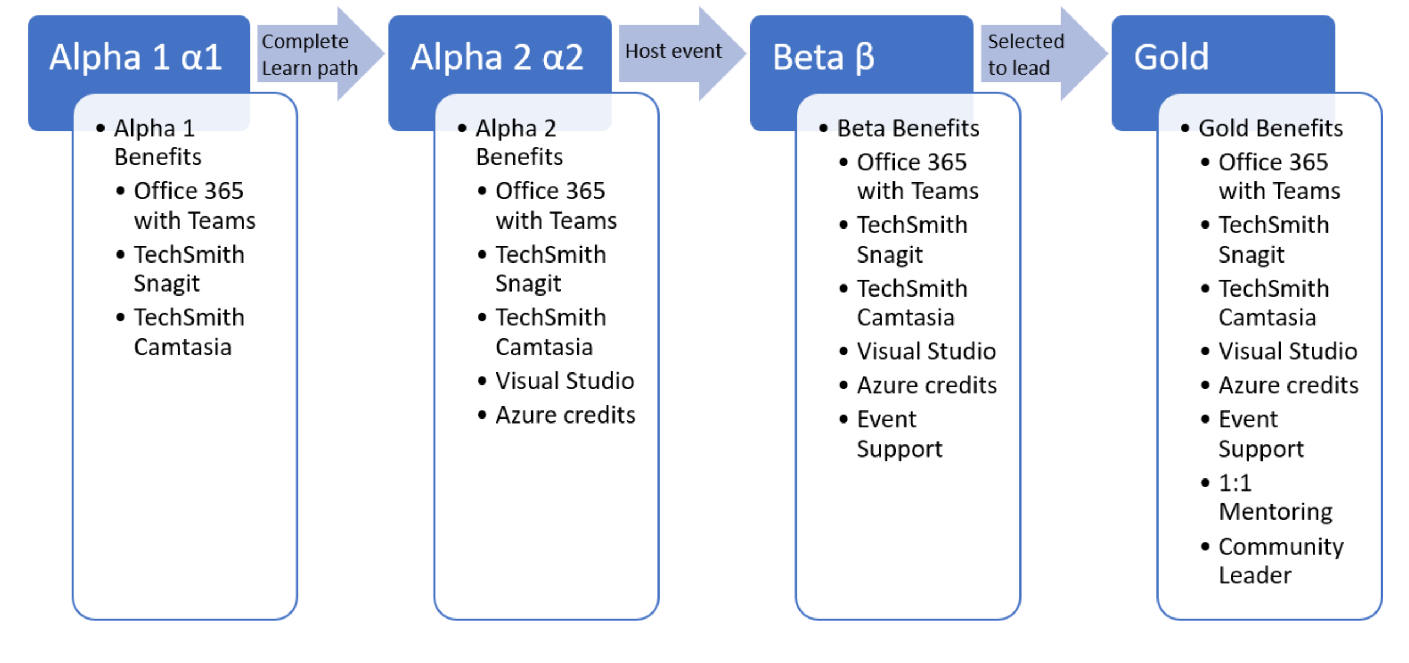
Badges, Benefits and Program Milestones
As you progress thru the program and complete various activities, you will advance program milestones, earn program badges and unlock program benefits. There are 4 program milestones and they are called Alpha 1, Alpha 2, Beta and Gold.

Slide 19
Any Queries??

Slide 20


Slide 21



Kartik Garg

